Slide 1
Image-to-Image Translation with Generative Adversarial Networks
Project Members
Ayush Goyal (16121007)
Naik Mayur Ravidas (16115075)
Mentors
Dr. Vinay Pant
Dr. Yogesh Vijay Hote

Slide 2
Motivation
Image-to-image translation involves generating a new synthetic version of a given image with a specific modification, such as translating a summer landscape to winter.
The goal is to learn the mapping between an input image and an output image using a training set of aligned image pairs. However, for many tasks, paired training data will not be available.
These datasets can be difficult and expensive to prepare, and in some cases impossible, such as photographs of paintings by long dead artists.

Slide 3
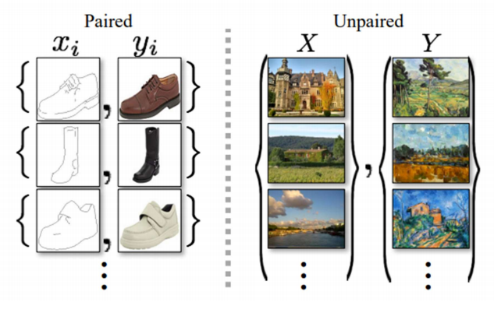
Paired vs Unpaired

Slide 4
Using GANs
Generative Adversarial Networks can provide a general-purpose solution to this problem.
Our goal is to translate an image from a source domain X to a target domain Y by learning a mapping G: X → Y such that the distribution of images from G(X) is indistinguishable from the distribution Y using an adversarial loss.

Slide 5
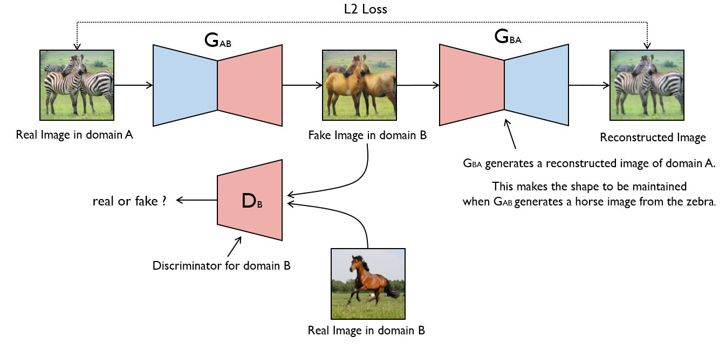
Network Architecture

Slide 6
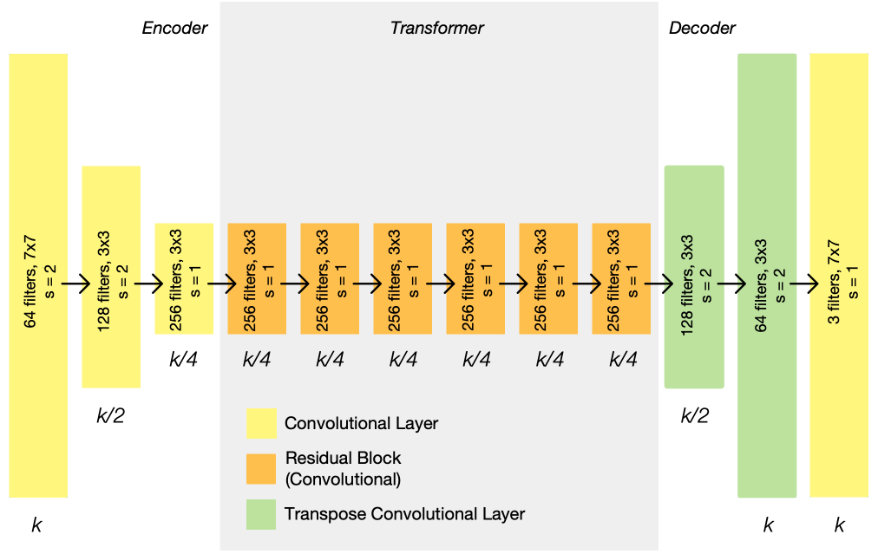
Generator Architecture

Slide 7
Datasets
Cityscapes label ↔ Photo
Maps ↔ Aerial photograph
Architectural facades labels ↔ photo
Edges → shoes
Horse ↔ Zebra and Apple ↔ Orange
Summer ↔ Winter Yosemite
Photo ↔ Art for style transfer
Monet’s paintings → photos
Flower photo enhancement

Slide 8
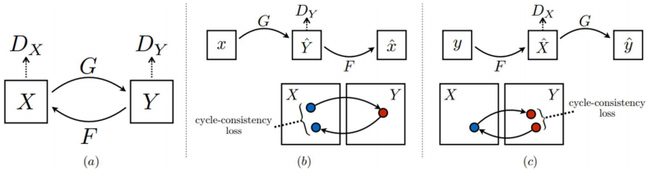
Loss Formulation
(a) Our model contains two mapping functions G: X → Y and F: Y → X, and associated adversarial discriminators DY and DX. DY encourages G to translate X into outputs indistinguishable from domain Y, and vice versa for DX and F. To further regularize the mappings, we introduce two cycle consistency losses that capture the intuition that if we translate from one domain to the other and back again we should arrive at where we started: (b) forward cycle-consistency loss: x → G(x) → F(G(x)) ≈ x, and (c) backward cycle-consistency loss: y → F(y) → G(F(y)) ≈ y.

Slide 9
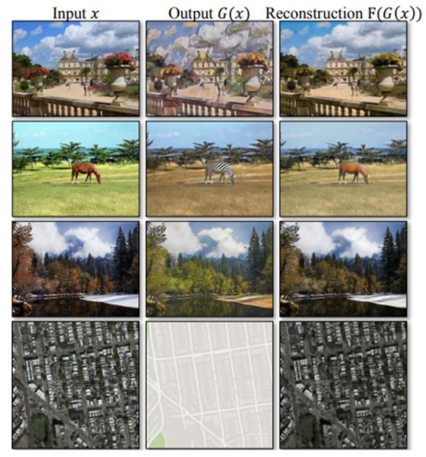
Cycle-consistency loss
The input images x, output images G(x) and the reconstructed images F(G(x)) from various experiments. From top to bottom: photo ↔ Cezanne, horses ↔ zebras, winter → summer Yosemite, aerial photos ↔ Google maps.

Slide 10

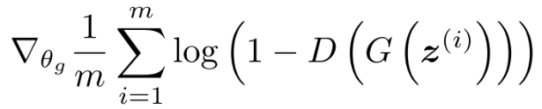
Loss Equations

Slide 11
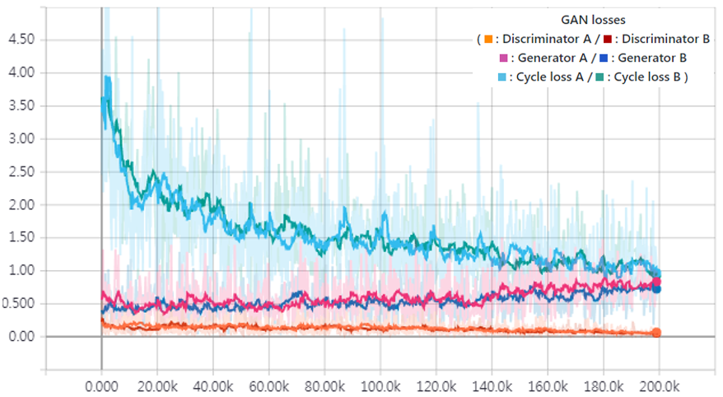
Training Losses

Slide 12
Applications
Collection Style Transfer
Object Transfiguration
Season Transfer
Photo generation from paintings
Photo Enhancement

Slide 13
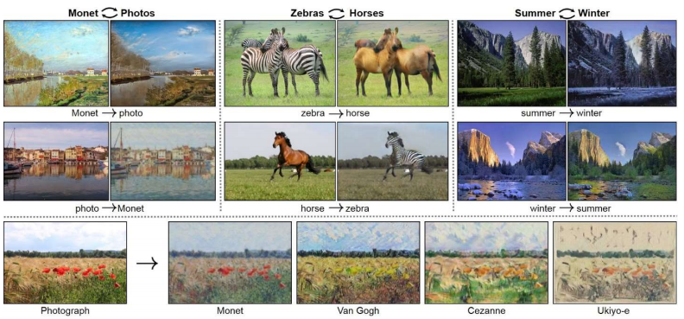
Results

